Slide 1
CS 528 - DEMO 1
Stop Wasting the Cloud
Mentors:
Dan Macpherson
Patrick Dillion
Team Members:
Anshu Goel
Jhukhirtha Marhi Arokiasamy
Sahil Gupta
Sidharth Bakshi
Vedant Mahabaleshwarkar

Slide 2

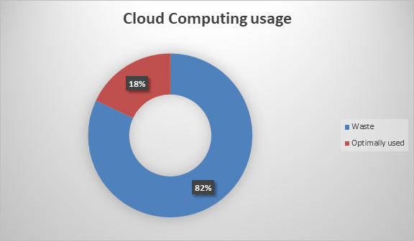
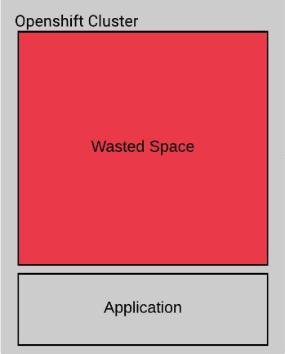
Motivation
Peterson, B. (2017). Companies waste $62 billion on the cloud by paying for capacity they don't need, according to a report. Retrieved from https://www.businessinsider.com/companies-waste-62-billion-on-the-cloud-by-paying-for-storage-they-dont-need-according-to-a-report-2017-11

Slide 3






Technologies being used:

Slide 4
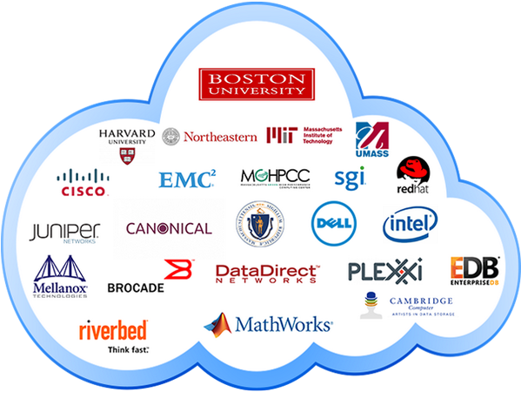
What is BOINC?
What is MOC?
BOINC (Berkeley Open Infrastructure for Network Computing) is an open source middleware system which supports volunteer and grid computing.
The Mass Open Cloud (MOC) is a new production public cloud that is a collaborative effort between higher education, government, non-profit entities and industry.
Red Hat OpenShift is an open source container application platform by Red Hat based on top of Docker containers and the Kubernetes container cluster manager for enterprise app development and deployment.
Docker containers wrap up software and its dependencies into a standardized unit for software development that includes everything it needs to run: code, runtime, system tools and libraries.
World Community Grid (WCG) is an effort to create the world's largest public computing grid to tackle scientific research projects that benefit humanity.

Slide 5
Vision and Goal
Develop an Open-Source solution to Optimize use of Slack Resources of Openshift Clusters on MOC without affecting other containers running in any given cluster
Extend this solution to Openshift Clusters on other public clouds.

Slide 6


Users/Personas
Cloud Server Administrators (MOC Admins/Owners)
Wants/Needs:
Clients paying for Openshift Clusters
Wants/Needs:
Use Slack Resources that I am paying for.
Unused cycles should run BOINC based applications such as computations of World Community Grid (WCG)
Run computations that consume slack resources of idle nodes that are not mapped to any clients/applications.

Slide 7
Solution Concept:
Deploying WCG projects based on the BOINC framework.
BOINC Applications will be deployed on the cloud server as Docker containers.
The container will be able to scale according to the resources available to it, which will be handled by the script in the DaemonSet.
Tuning at the Kubernetes and BOINC tiers in order to scale the unused resources to the existing jobs.
Automated sizing which would enable us to create/kill instances of containers depending upon the available resources.
Allowing jobs to utilize persistent storage so that they can resume from their last state in case they get killed before completion.
In order to achieve maximum utilization of the cloud server resources, the following two strategies can be employed:
Having a single BOINC app per node that consumes all the slack resources on that node
Having multiple BOINC apps per node that divide the slack resources on a node between themselves.

Slide 8
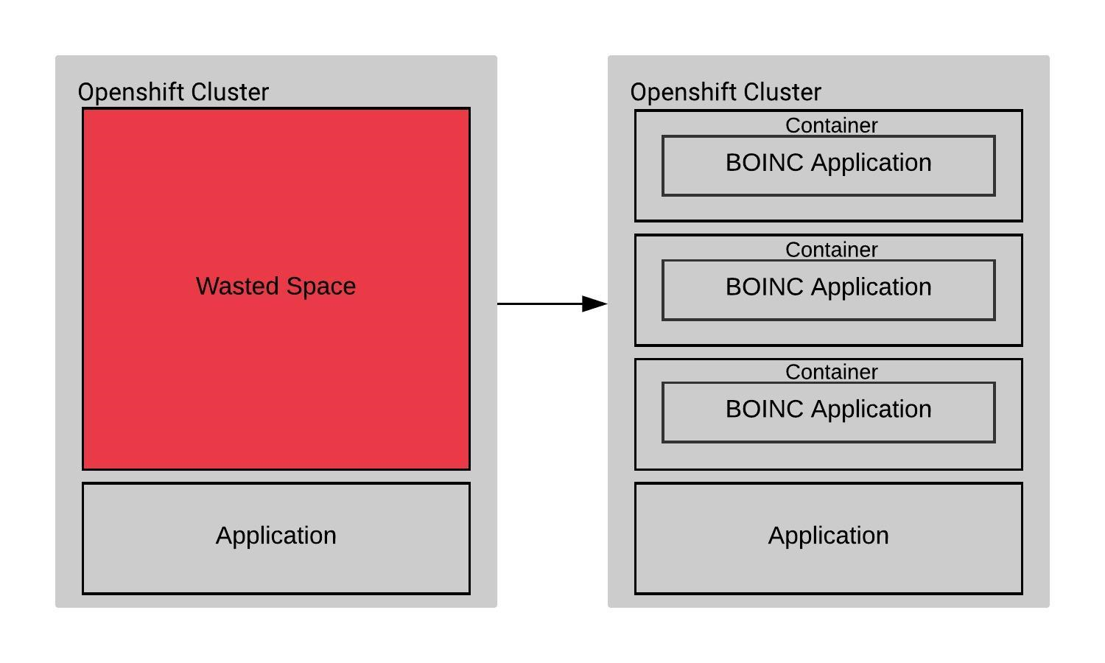
HOW??
Deploy a BOINC based CentOS image on the Openshift cluster in the MOC as a daemonset.

Slide 9
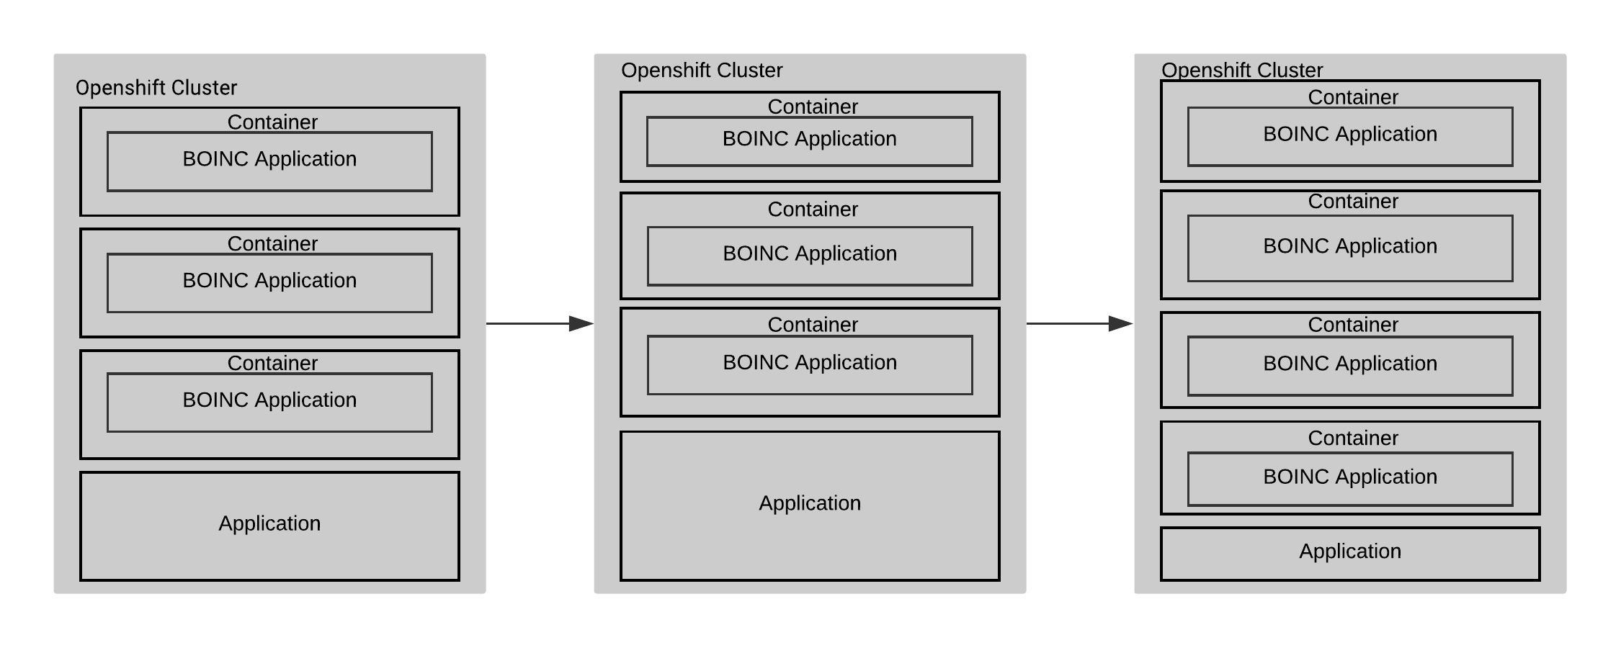
HOW??
Define an algorithm that allows the container to scale dynamically according to the available resources on each node in the OpenShift cluster. This includes allowing the container to scale out to the size of the entire node when resources are available, and to scale down to practically consume nothing, or get killed when the resources are not available. If the container gets killed, it will be able efficiently re-execute when resources are available again.

Slide 10
Release Plannings
Sprint 1: 14th February 2019
Story: Create a BOINC based Docker Image
Tasks:
Research and Learn about BOINC, Openshift, Docker, CentOS, WCG, MOC etc.
Get Access to MOC
Deploy container in Local Host

Slide 11
Future Sprints
Sprint 2: 28th February 2019
Deploy BOINC based CentOS image as a daemonset in OpenShift cluster
Sprint 3: 21th March 2019
Define the algorithm for resource allocation and scaling.
Sprint 4: 4th April 2019
Fine-tune the algorithm for resource allocation and scaling.
Sprint 5: 18th April 2019
Work towards stretch goals if possible/ complete backlog

Slide 12
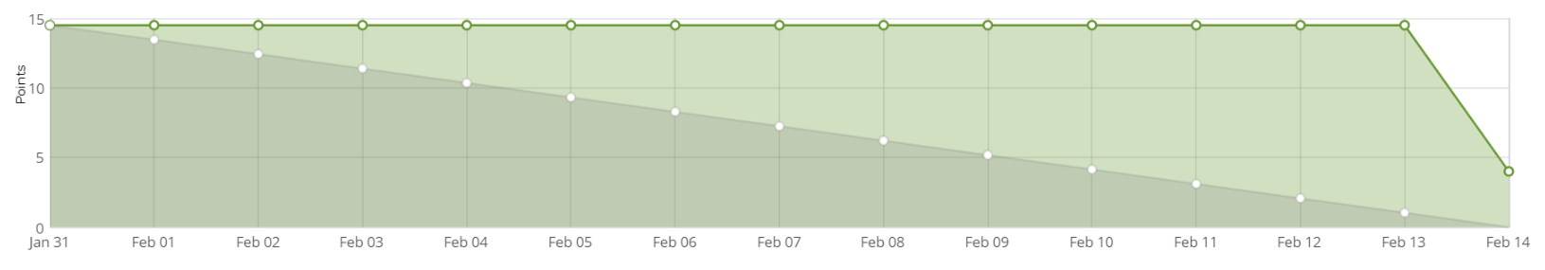
Burndown Chart

Slide 13
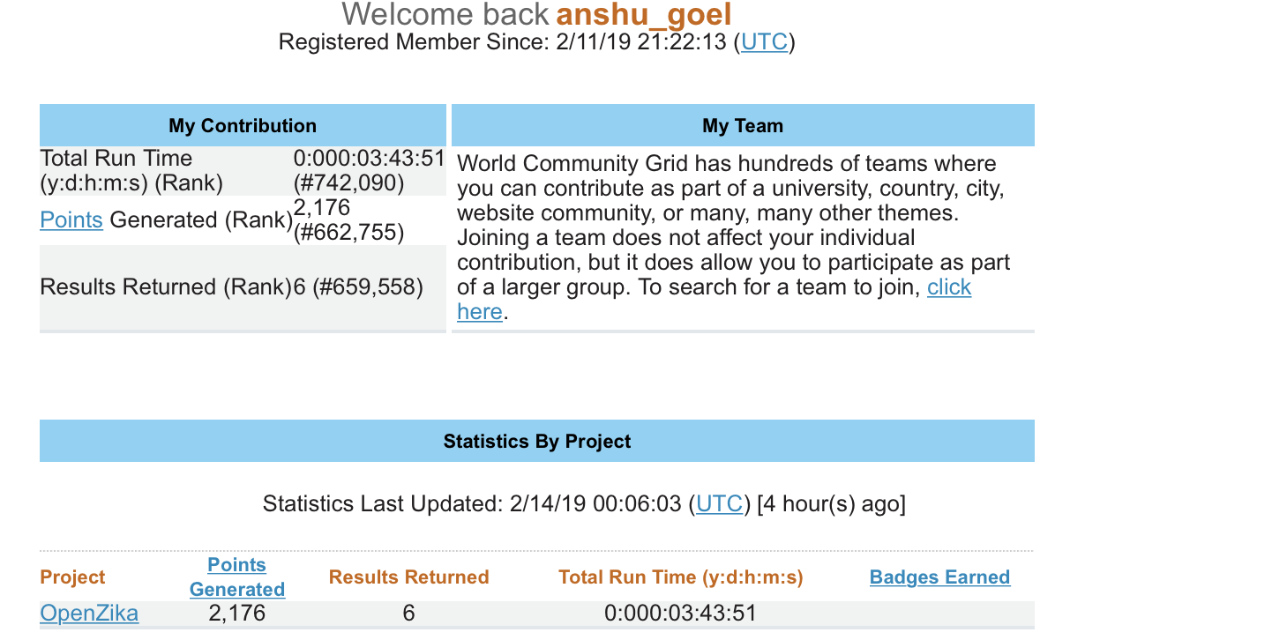
DEMO

Slide 14
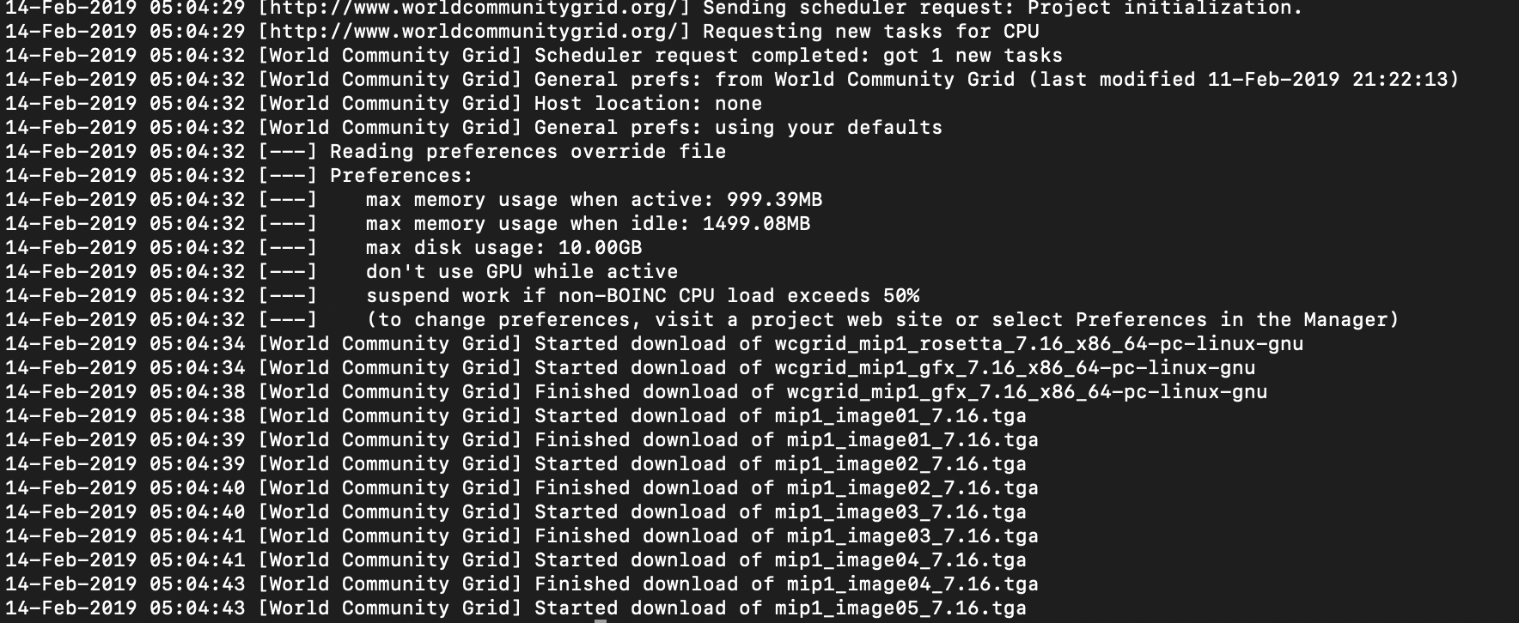

Slide 15
QUESTIONS?

